Slide 1

PROJECT PPT FOR EIGHT JAPAN
NISHANTH D KINI
9.24.XX

Slide 2

Agenda
INTRODUCTION
ArcGIS INFO
SCREENSHOTS

Slide 3

INTRODUCTION
ArcGIS DATA ANALYSIS using INSIGHTS
ArcGIS Insights is an analytics workbench that allows you to perform iterative and exploratory data analysis. You can answer questions with data from ArcGIS, Excel spreadsheets, business databases, and more by simply dragging the data to perform analysis.
A Geographic Information System (GIS) is a computer system that analyzes and displays geographically referenced information. It uses data that is attached to a unique location.

Slide 4

2011 Tohoku disaster analysis
Let’s Dive In

Slide 5
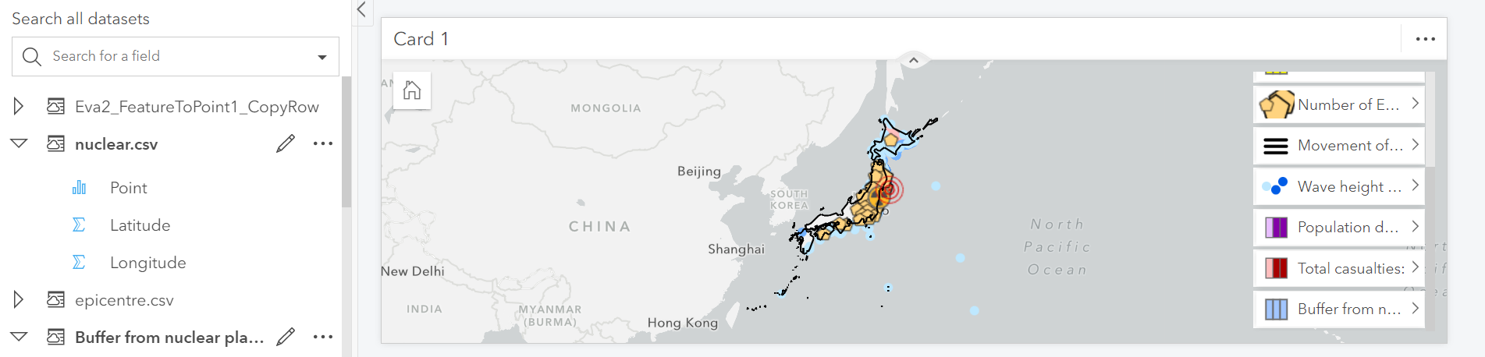
Data Analysis using ArcGIS insights

Slide 6
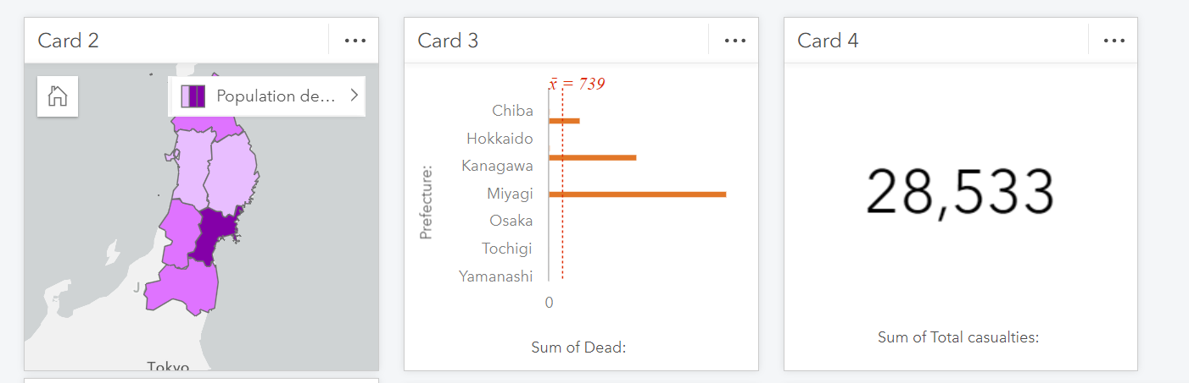
TOHOKU REGIONS ALONG WITH THE COUNT OF DEAD AND THE TOTAL CASUALTIES…

Slide 7
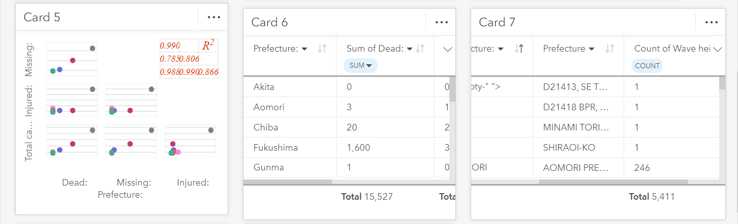
ANALYSIS OF THE DEAD, MISSING AND THE INJURED IN THAT REGION…..

Slide 8
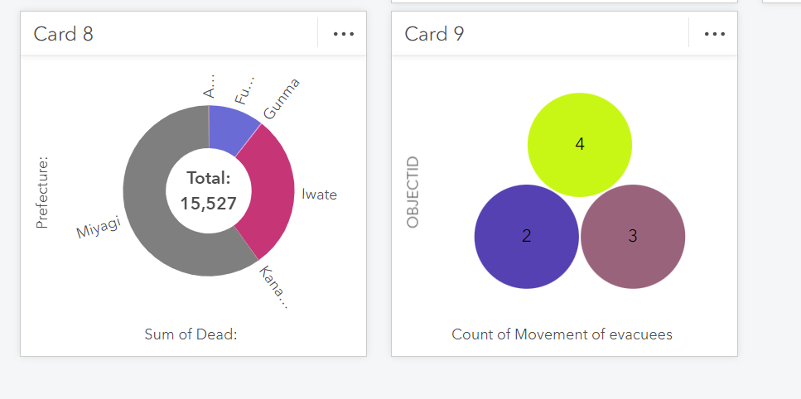
A SATISFIED CUTOMER
FABRIKAM WAS GREAT TO WORK WITH. LARISSA WAS MY REPRESENTATIVE AND SHE ANTICIPATED MY NEEDS AND WORKED DILIGENTLY TO FIX MY ISSUE.
SOME MORE ANALYSIS….

Slide 9

USA SALES ANALYSIS
LOOKING AHEAD

Slide 10
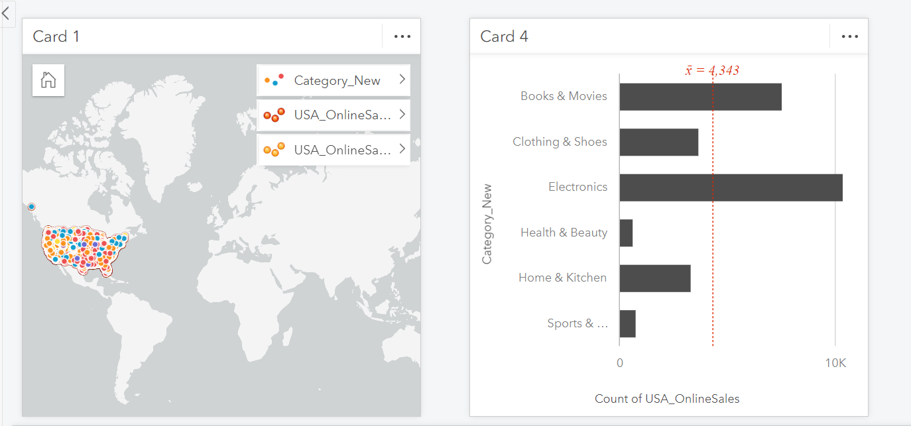
quarterly timeline
SALES ANALYSIS BASED ON CATEGORY USING ArcGIS

Slide 11
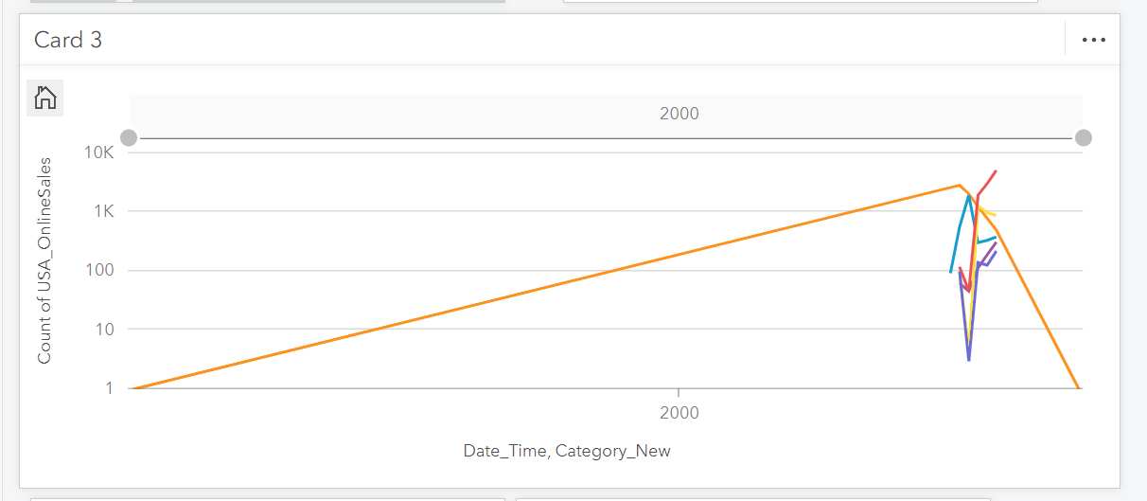
Goals for q2
TIMELINE GRAPH

Slide 12
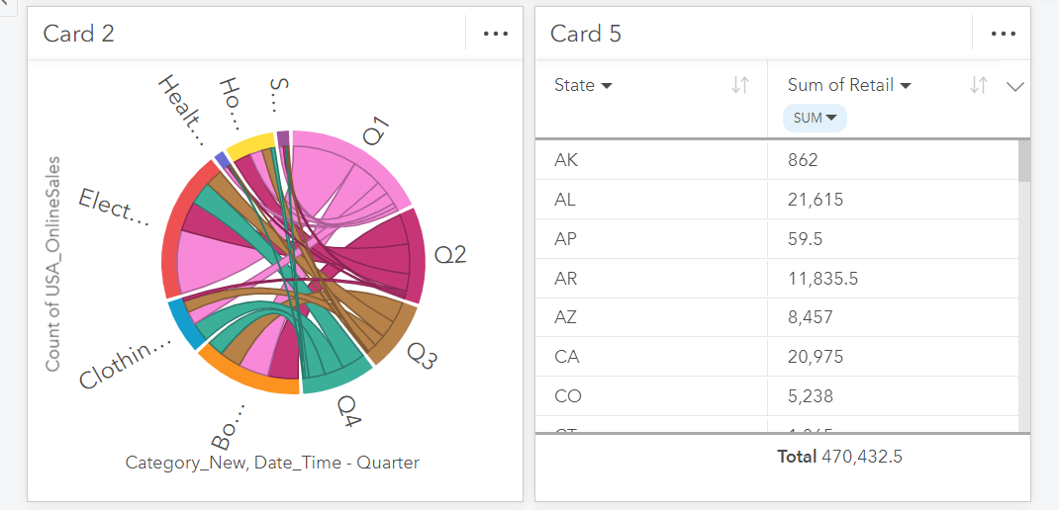

Slide 13
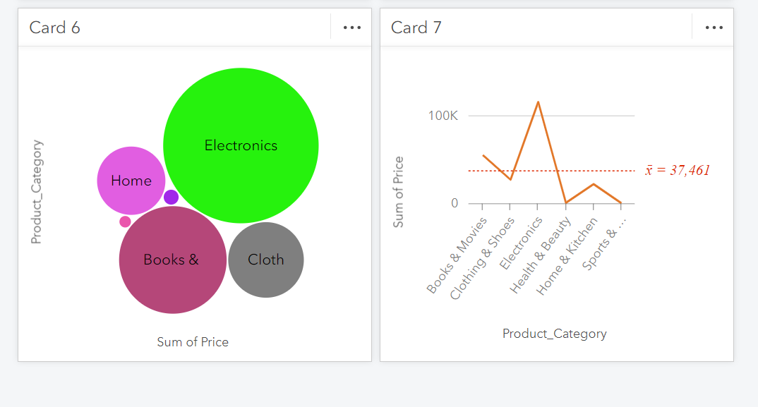

Slide 14



THANK YOU
NISHANTH D KINI
+91 7795883750
nishanthkini27@gmail.com

